Slide 1


Slide 2


Safe Eye
Second Year Project Synopsis
Submitted by
ROLL | NAME
2301730294 | Kashish
2301730307 | Mehak
2301930283 | Anmol Nagal
2301730291 | Shubham
Industry Mentor: Mr. Vijay Chaudhary
Faculty Mentor: Mr. Vishwanil Suman
Notes:
New Courses replaced with New Programmes

Slide 3
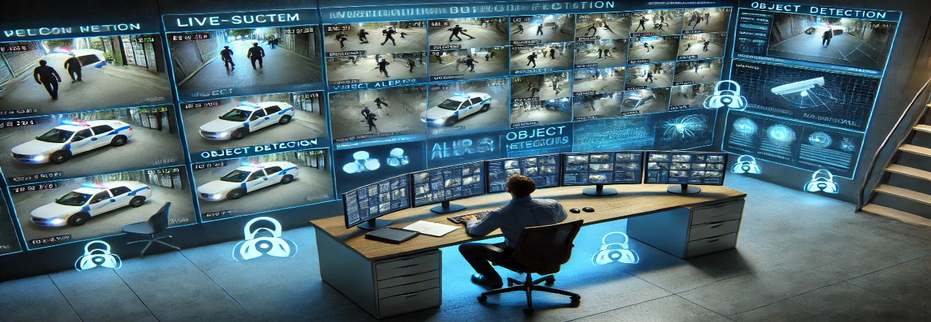

Project Overview
SAFE EYE is an AI-powered real-time crime detection and alert system designed to enhance public safety in smart cities. The system uses computer vision techniques to monitor CCTV footage and identify suspicious or criminal activities such as fights, thefts, robberies, illegal parking, and other anomalies. Upon detection, the system immediately triggers alerts to authorities, enabling quick response and prevention.
Notes:
New Courses replaced with New Programmes

Slide 4
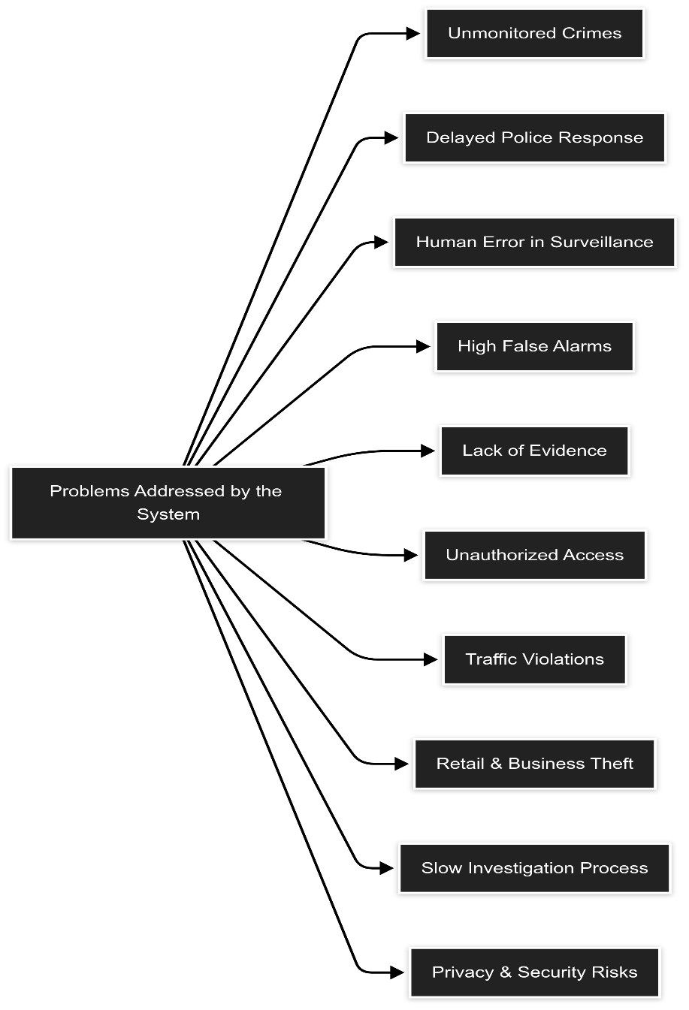
About the Problem
1. Crimes like theft, fights or illegal activities often go unnoticed due to lack of constant monitoring.
2. Without instant alerts, Authorities may arrive too late to prevent or stop a crime.
3. Crimes are often hard to prove without clear footage and timestamps.
4. Some unauthorized people enter restricted areas without permission.
5. Traffic violations such as illegal parking, accidents or reckless driving.
6. Security Staff may miss important incidents due to fatigue or distractions.
7. Traditional security systems may generate false alerts, leading to wasted resources.
Notes:
New Courses replaced with New Programmes

Slide 5
Problem Statement
Problem Statement :
Urban areas face undetected crimes like theft, fights, and illegal parking due to manual surveillance monitoring. There is a need for an automated system that analyzes live CCTV footage in real-time to detect suspicious activities and alert authorities immediately.
Solution :
Real-time detection allows for quick responses,
preventing harm and property loss.
Automation reduces the need for constant
human supervision, optimizing resources.
Early detection enables timely intervention,
reducing crime rates and preventing escalation.
Improves city security and traffic management
by monitoring public spaces proactively.
Notes:
New Courses replaced with New Programmes

Slide 6
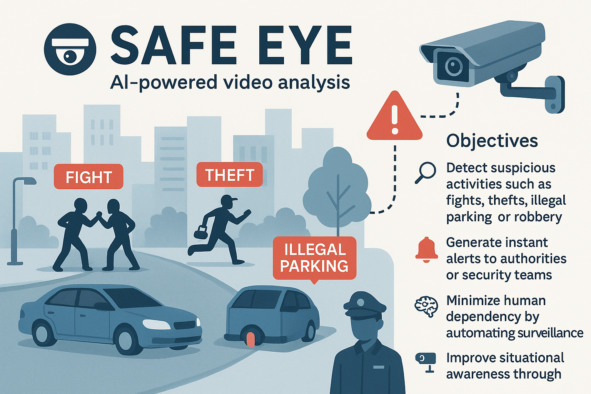
Objectives
The primary goal of SAFE EYE is to enhance public safety by turning surveillance systems into real-time crime detection tools. Specific objectives include:
Detect suspicious activities such as fights, thefts, illegal parking, or robbery using AI-powered video analysis.
Generate instant alerts to authorities or security teams via SMS, app, or dashboard notifications.
Minimize human dependency by automating surveillance with intelligent decision-making.
Improve situational awareness through continuous and proactive monitoring.
Support scalable deployment across cities, campuses, malls, and transport hubs.
Notes:
New Courses replaced with New Programmes

Slide 7
Methodology, Tools, and Techniques
Methodology
Step 1: Video Input (CCTV Feed) Live surveillance video is captured from installed CCTV cameras.
Step 2: Frame Extraction Video is split into individual frames for real-time analysis.
Step 3: Preprocessing Frames are cleaned and resized using OpenCV for accurate detection.
Step 4: Object & Activity Detection YOLO/CNN models detect people, vehicles, and actions like fighting, theft, or illegal parking.
Step 5: Anomaly Detection Suspicious behaviors are identified using predefined threat models.
Step 6: Alert Generation If an anomaly is found, automatic alerts are sent via SMS or app notifications.
Step 7: Event Logging All incidents are stored with timestamps, activity type, and captured frame for future review.
Notes:
New Courses replaced with New Programmes

Slide 8
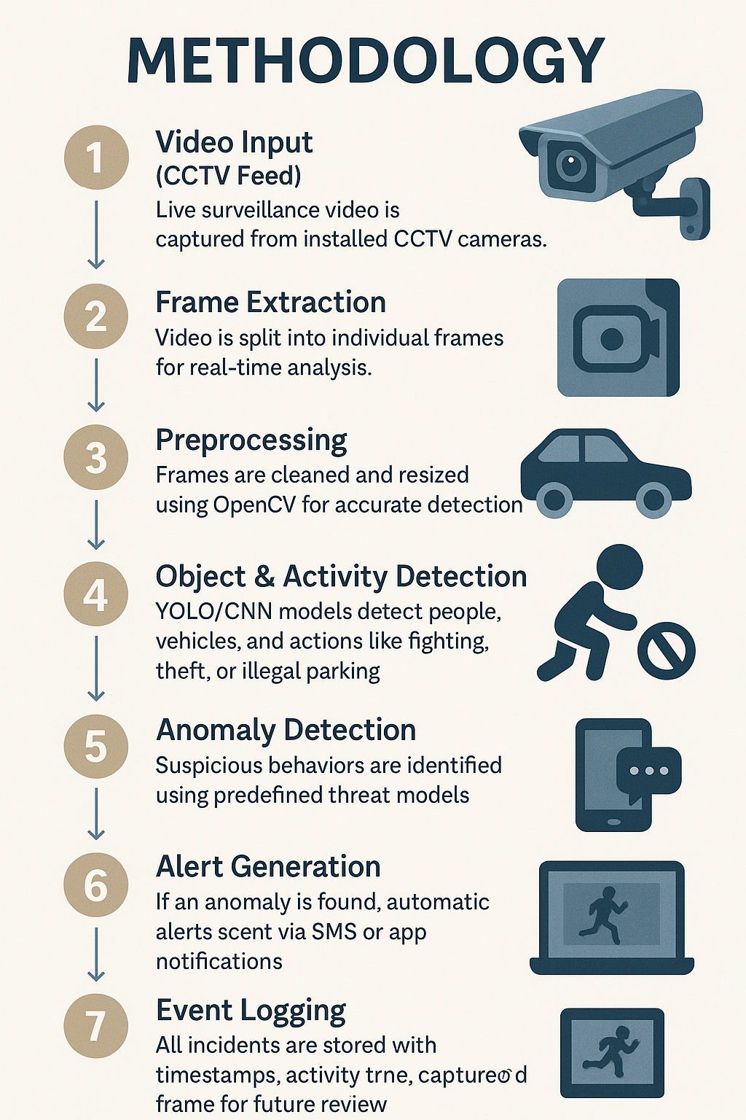
Flowchart
Notes:
New Courses replaced with New Programmes

Slide 9
Tools and Techniques
Tools & Technologies:
Python – Core language for development and scripting
OpenCV – For image processing and video analysis
YOLO (You Only Look Once) – Real-time object detection model
TensorFlow / PyTorch – Deep learning frameworks for model training
Flask / FastAPI – Lightweight web frameworks for deployment
Twilio / SMTP – APIs for sending alerts via SMS or email
MongoDB / SQLite – Databases for logging and storing incident data
Techniques:
Object Detection – Identifying people, vehicles, and items in video frames
Activity Recognition – Detecting actions like fights, theft, and parking violations
Anomaly Detection – Spotting unusual or suspicious behaviour
Real-time Video Processing – Live frame-by-frame surveillance analysis
Automated Alert System – Triggering notifications without human input
Notes:
New Courses replaced with New Programmes

Slide 10
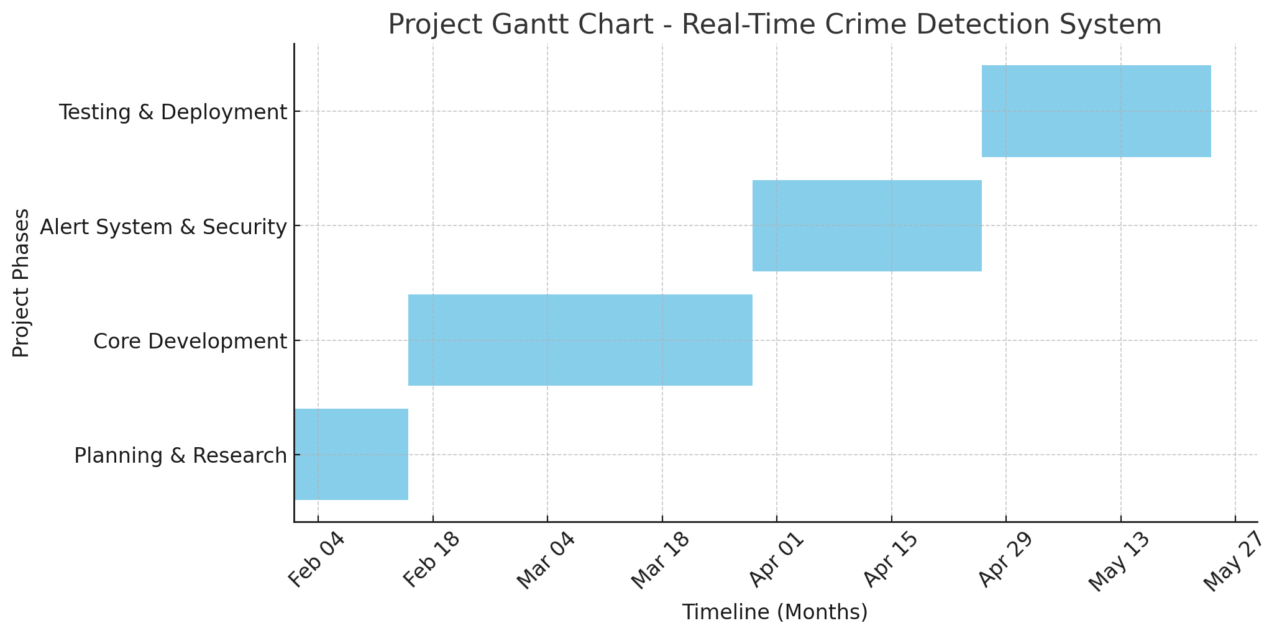
Project Timeline
1. Planning & Research (2 Weeks) - Define objectives and research technologies (YOLOv8, WebRTC, Django/Flask).
2. Core Development (6 Weeks) - Implement YOLOv8, build backend (Django/Flask), and frontend (React.js) with video streaming.
3. Alert System & Security (4 Weeks) - Set up notifications and implement encryption with role-based access.
4. Testing & Deployment (4 Weeks) - Perform testing, fix bugs, optimize performance, and deploy on the cloud.
Notes:
New Courses replaced with New Programmes

Slide 11
Expected Results & Impact
Expected Result :
Real-Time Detection: The system detects suspicious activities like fights or theft in real-time from CCTV feeds.
Instant Alerts: Authorities receive immediate notifications with video snippets for quick action.
Efficient Review: A web dashboard allows authorities to manage and validate flagged incidents securely.
Secure Data Handling: Video footage and user data will be stored securely with encryption and role-based access.
Impact :
Increased Public Safety: Faster responses to crimes will improve safety in public spaces.
Better Law Enforcement: Authorities can respond more effectively to crimes.
Crime Prevention: Quick alerts help prevent incidents before they escalate.
Improved Traffic Management: Tracks violations like illegal parking.
Privacy and Security: Ensures secure handling of sensitive data with encryption.
Notes:
New Courses replaced with New Programmes

Slide 12
References
Redmon, J., Divvala, S., Girshick, R., & Farhadi, A. (2016). You Only Look Once:
Unified, Real-Time Object Detection. arXiv:1506.02640. Available at:
https://arxiv.org/abs/1506.02640
OpenCV Documentation. Available at: https://docs.opencv.org
TensorFlow Object Detection API. Available at:
https://www.tensorflow.org/lite/models/object_detection
Twilio SMS API Documentation. Available at:
https://www.twilio.com/docs/sms
Sultana, A., & Manikandan, R. (2020). Smart Surveillance System using
Artificial Intelligence. International Journal of Engineering Research &
Technology (IJERT).
PyTorch Documentation. Available at: https://pytorch.org/docs/
IEEE Xplore. Real-time Anomaly Detection in Surveillance Videos. Available at:
https://ieeexplore.ieee.org
Notes:
New Courses replaced with New Programmes

Slide 13
THANK YOU

